Slide 1
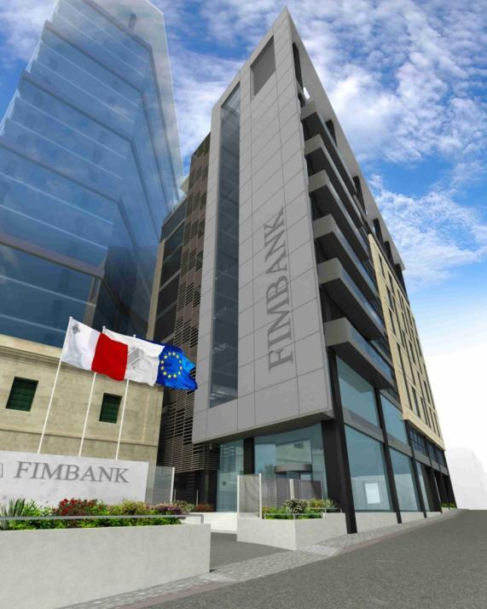
FORFAITING
The Basics and Future
Moscow
22nd of May 2014
Margrith Lütschg – Emmenegger
President of FIMBank Group
Notes:
1

Slide 2
What will we discuss together
Forfaiting : The Basics
Comparison with other Trade Finance Products
Case Study
Forfaiting : The Future

Slide 3
Forfaiting in FIMBank
Delivering Trade Finance Solutions since 1984
● Brazil, Sao Paolo
● Russia, Moscow
● Singapore
● Turkey, Istanbul
● UK, London [HQ]
● USA, New York
In business since 1984
100%-owned by FIMBank since 2003
Strong Brand in the industry
Established Forfaiting House
Global Network of Offices
Deals Worldwide
Many Awards by GTR/TFR

Slide 4
Forfaiting: The Basics

Slide 5
Forfaiting : The Basics
Definition:
Forfaiting is the buy / sell on “Without Recourse” basis of international trade receivables materialized in negotiable instruments (e.g. P/Ns, B/Es, …).
History
East-West Trade
Child of the Cold War
Markets
Primary
Secondary
Centers
London,
Zurich,
New York,
Singapore,
Gulf Region
Characteristics:
Tenors from 6 months to 10 years;
Amounts of min US$100,000;
All major currencies;
Non recourse to seller/ endorser;
Negotiable instruments;
Usually guaranteed by a financial or sovereign institution
Negotiable Instruments:
Letter of Credit;
Promissory Note;
Accepted Bill of Exchange;
Receivables Book with separate Guarantee
Financial Lease installments with Guarantee

Slide 6
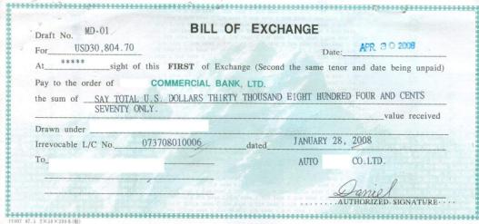
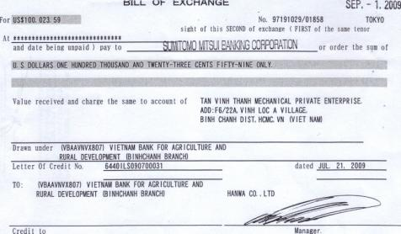
Bill of Exchange (samples)
BILL OF EXCHANGE
Per Aval For Acceptance … … … … … … … Amount … … … … … … … …
for (Place and Date of Issue)
account
of the At/On … … … … … … … … … … for value received, pay against this
Drawee Bill of Exchange to the order of … … … … … … … … …
the sum of … … … … … … … … … … … … … … …
effective payment to be made in … … … … … … ,
without deductions, for and free of any taxes, duties or imposts
of any nature.
This Bill of Exchange is payable at … … … … … … …
Drawn on: Drawer:
… … … … … … … … … … … … … …
… … … … … … … … … … … … … …
Unconditional Obligations of payment on behalf of the Obligor

Slide 7
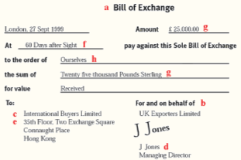
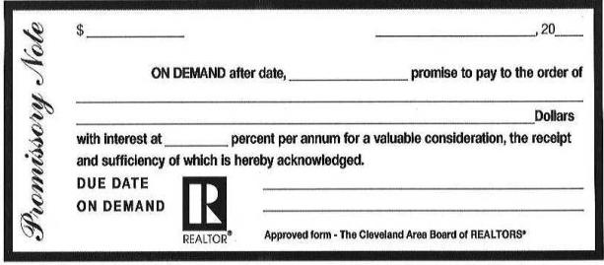
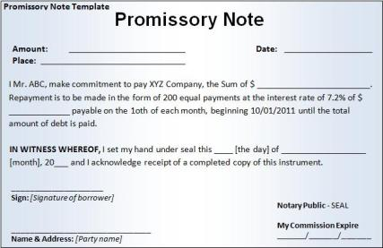
Promissory Note (samples)
PROMISSORY NOTE
Per Aval … … … … … … … … … … … … … … …
(amount in figures)
… … … … … … … … … … … … … … … … … … … …
(place of Issue) (date of Issue)
On … … … … … … … … … … against this Promissory Note I (We) promise to pay
to … … … … … … … … … … … or Order the sum of … … … … … … … … … … … … … … … …
(amount in words)
effective payment to be made in … … … … … … … … , without deduction for and
free of any taxes, impost, levies or duties present or future of any nature.
For Value Received
Payable at:
… … … … … … … … … Signature of maker:
… … … … … … …
Unconditional Obligations of payment on behalf of the Obligor
Stamps on the reverse side

Slide 8
Forfaiting : The Price (brief overview)
COFFEE
Discount Rate
DOGS
Commitment Fee
Charged for the period required to process the discounting from the moment of commitment for the deal.
- - - - - - - - - - -
(Production period)
Effective interest rate
Cost of Funding
Size of Transaction
Credit Rating of Obligor Country
Credit Rating of Guarantee Bank/ Corporate Risk
Availability
Days of Grace
No. of days delay in receiving payments for the instrument (added to the discounting period)
- - - - - - - - - - - -
linked to the
location and risk of
the Obligor
Straight Discount:
Percentage discounted from the face value given the tenor
Discount to Yield:
Percentage applied as a true interest cost, on a per annum basis
Fixed Rate:
Investor/Forfaiter commits to a fixed rate for the entire discounting period;
Fixed Spread:
Investor/Forfaiter commits to a “fixed margin” over a market rate (EURIBOR, LIBOR) during the discounting period
Typical
Discounting
Quote
Options
Straight Discount
Net Proceeds = Face Value – Discount Amount
Discount Rate * Face Value * No. Days
Discount Amount = --------------------------------------------------------
360 * 100
Discount to Yield
Face Value
Net Proceeds = -----------------
Divisor
Discount Rate * No. Days
Divisor = --------------------------------------- + 1
360 * 100

Slide 9
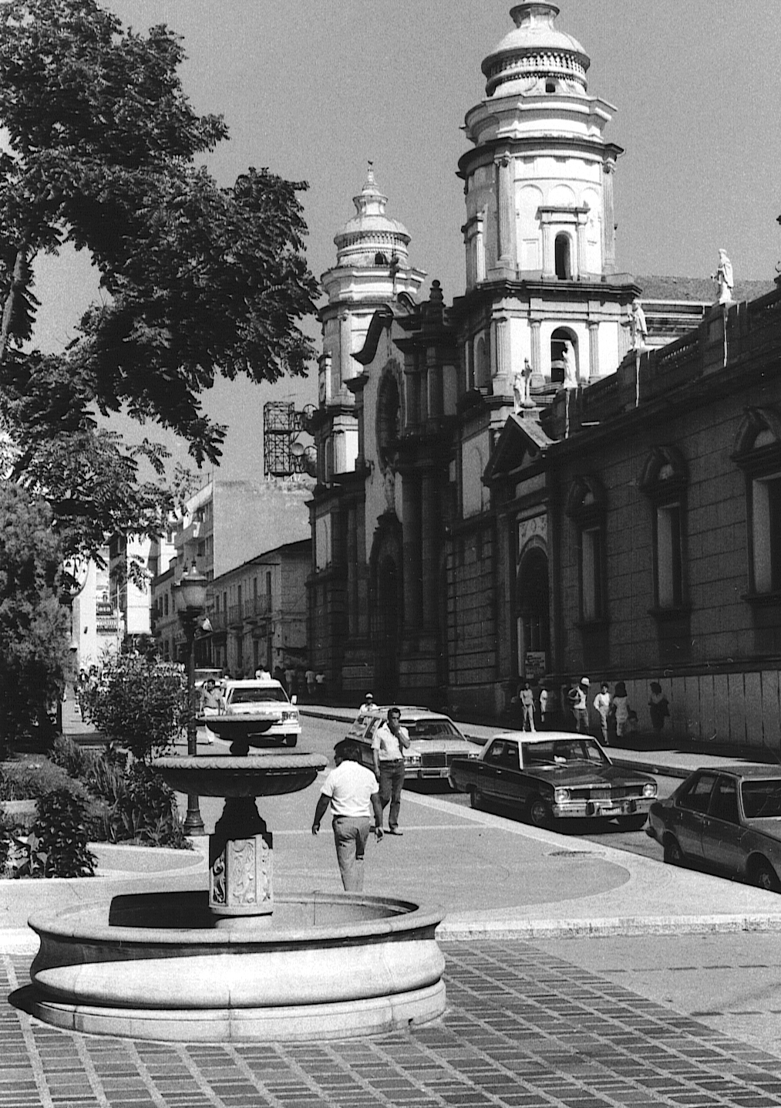
Forfaiting : Information required
Country of Obligor
Obligor’s name
Type of goods
Value of goods
Expected shipment date
Repayment terms sought by the Obligor
Name of the Guarantor for the Obligor (if existing)
Bangladesh
Mali
Venezuela
Belarus
Honduras
Indonesia

Slide 10
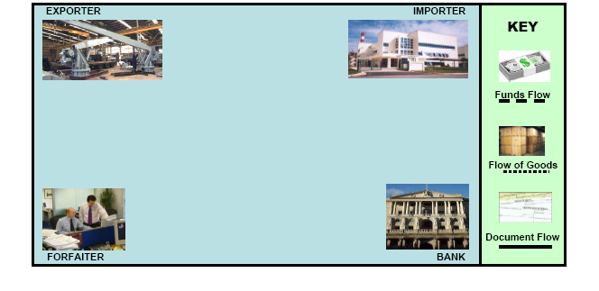
Forfaiting : Typical Transaction Flow
2.
4.
5.
1.
6.
7.
3.
9.
8.
10.
Forfaiter commits to purchase deal from the Exporter
Commercial contract between Exporter and Importer
Bank gives guarantee/ aval
Delivery of goods from Exporter to Importer
Importer hands over documents to Exporter
Exporter delivers documents to the Forfaiter
Forfaiter pays cash ‘without recourse’ to the Exporter
Forfaiter presents documents to Bank at maturity for payment
Importer repays Bank at maturity
Bank repays Forfaiter at maturity
What Next ?
After discounting the Forfaiter can (a) hold the instruments to maturity and claim payment from the Obligor/Guarantor or
(b) sell them to third parties through Trading on secondary market => in our opinion this is the “True Forfaiting”

Slide 11
Forfaiting : Typical Goods
Market Size
There are no official statistics on the actual size of the Forfaiting Market; however, is has been estimated that volumes could be as high as:
US$30 billion of new business per annum; and
US$60-75 billion outstanding at anyone time
Building Projects
(e.g. Hotel/Hospital
Projects)
Machinery
(Tools/Ceramic
Production)
Trucks
Soccer Players
Construction
Equipment
Commodities
(Grain, oil etc)

Slide 12
Forfaiting : Benefits
Finances 100% of the contract value
Enables Exporter to offer credit terms
Sale is made on a without recourse basis
Financing is off balance sheet
Simple & Concise Documentation
Quick Decisions
Improves Cash Flow
Services, Foreign and Local works can be financed

Slide 13
Forfaiting vs. Factoring
Forfaiting:
Single transaction based
Negotiable instruments
L/C or bank acceptances required
Primarily a financing service
Medium/Long term transaction which would be ‘one-off’
Without recourse
Usually for export receivables
Minimum transaction size: US$100,000
100% financing
Factoring:
On-going arrangement
Non-negotiable instruments
Open account sale
Provides other than financing services
Used for offering short-term credit to regular buyers
Both with and without recourse
For domestic and export receivables
No minimum size
A percentage is normally retained

Slide 14
Forfaiting: Comparison with other Trade Finance Products
TRADING

Slide 15
Forfaiting : Key Ingredients of TRADING
Credit Risk Appetite
Delivering Trade Finance Solutions since 1984
Funding
Capacity
Underwriting
Capacity
Good IT Resources
Electronic access to documents
Manage Portfolio
Maintain Counterparty Data

Slide 16
TRADING : looking into details
Originating
the assets
Structuring
the transaction
Identify
Buyers / Investors
Pricing Considerations
Evaluation of Credit Risk Perception
Evaluation of Interest Rate Risk
Any Benchmarks ?
Market Knowledge/Placing Power
Experience
Documentation
Well Structured
Unconditional Confirmations
Incorporate Local Requirements
Irrevocable
Freely Transferable
Sales Considerations
Opportunity
Deteriorating Risk Perception
Limit Considerations
Funding Considerations
Replace Asset with New Deal
When to Sell ?
Sell Immediately – minimum risk, minimum return
Sell later – keep fees, yield
Hold to maturity – short term/small deals
Who Buys ?
International Banks
Funds
Secondary Market
Specialist Forfaiting Houses
Why Trade ?
Portfolio/Funding Constraints
Risk Mitigation
Limit Constraints
Higher Returns on Equity
More Business Opportunities with Limited Resources
Assists with accurate pricing for new deals
Offers greater risk capacity to clients
Increase the International profile of the Group

Slide 17
Trading enhances the service which you can provide to your clients and extends portfolio management options to your Bank

Slide 18
Case Study

Slide 19
Case Study (M/LT Financing)
Initial Stage
Country: Philippines
Importer: Medium-sized garment producer
Amount: Euro 3,500,000
Instrument: Bills of Exchange
Tenor: As long as possible
Delivery: In 2 months
Underlying Export of textile machinery
transaction:
Financing proposal by Forfaiter
Financing Bills of Exchange to be
terms: accepted by Importer and avalized (guaranteed) by a
prime Bank in the Philippines
Financing 3 years (6 semi-annual
period: installments)
Discounting Eurobor average life of
rate: transaction (1,75 years) plus
4 % p.a. discount to yield
compounded semi-annually
Days of 3 days
grace:
Commitment 1,5 % p.a.,
fee: payable at discount
Required documentation
Set of 10 Bills of Exchange (originals) accepted by Importer and avalized by Bank of the Philippine Islands
B/E’s need to be duly endorsed to FIMBANK
Confirmation that Importer’s signatures on B/E’s are authentic and validly binding
Confirmation that avalizing Bank’s signatures on B/E’s are authentic and validly binding
Certified true copy of
Commercial Invoice(s)
Bill(s) of Lading

Slide 20
Forfaiting : The Future

Slide 21
Forfaiting : The Future
Increasing alternative to traditional bank finance as commercial banks exit the trade finance market post Global Financial Crises.
Complementary component to structured and project related finance.
Innovative application to non standard debt transactions
e.g. Lease stream, Progress Payments, Corporate Finance etc.
Attractive asset class for 3rd party investors
e.g. Hedge funds, Insurance Funds, Private Banks etc.
Forfaiting is both a debt product and an investment product straddling the commercial and investment banking activities of most Financial Institutions.

Slide 23
We cannot change the direction of the wind,
however we can always adjust our sails!
Notes:
23

